Slide 1
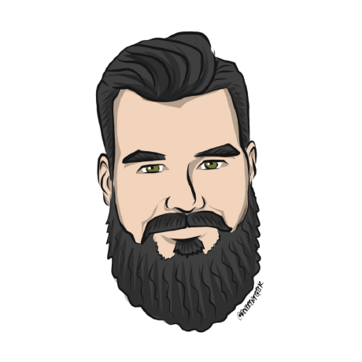


An introduction to Docker
Terry McCann | @SQLShark

Slide 2

Bad old days
Server
Server
App
App
OS
OS
Server
Server
App
App
OS
OS
Notes:
So with that you have all the costs associated.
Each new application needs to have its own server, space for the server disks and ram and CPU.
We don’t want the app to run slow this would typui

Slide 3

Traditional Virtualisation
App
App
App
App
OS
OS
OS
OS
Virtual Machine
Virtual Machine
Virtual Machine
Virtual Machine
Hypervisor
Server
Notes:
We could run many applications on the same server
It was not a perfect solution!
Server > Apps > VM > OS We have to pay for all of those OS
We need to feed and care for each of them. Who wants their models to be taken down

Slide 4
Docker
App
App
App
App
Free space
OS
Server
Notes:
We could run many applications on the same server
It was not a perfect solution!
Server > Apps > VM > OS We have to pay for all of those OS
We need to feed and care for each of them. Who wants their models to be taken down

Slide 5
Docker Demo
Hello World!
Notes:
Docker run hello-world
docker run -d --name web -p 8080:8080 nigelpoulton/pluralsight-docker-ci

Slide 6
Lab 04 - Hello World! in Docker
10 minutes

Slide 7
Docker Container registries
Notes:
docker run -d --name web -p 8080:8080 nigelpoulton/pluralsight-docker-ci

Slide 8
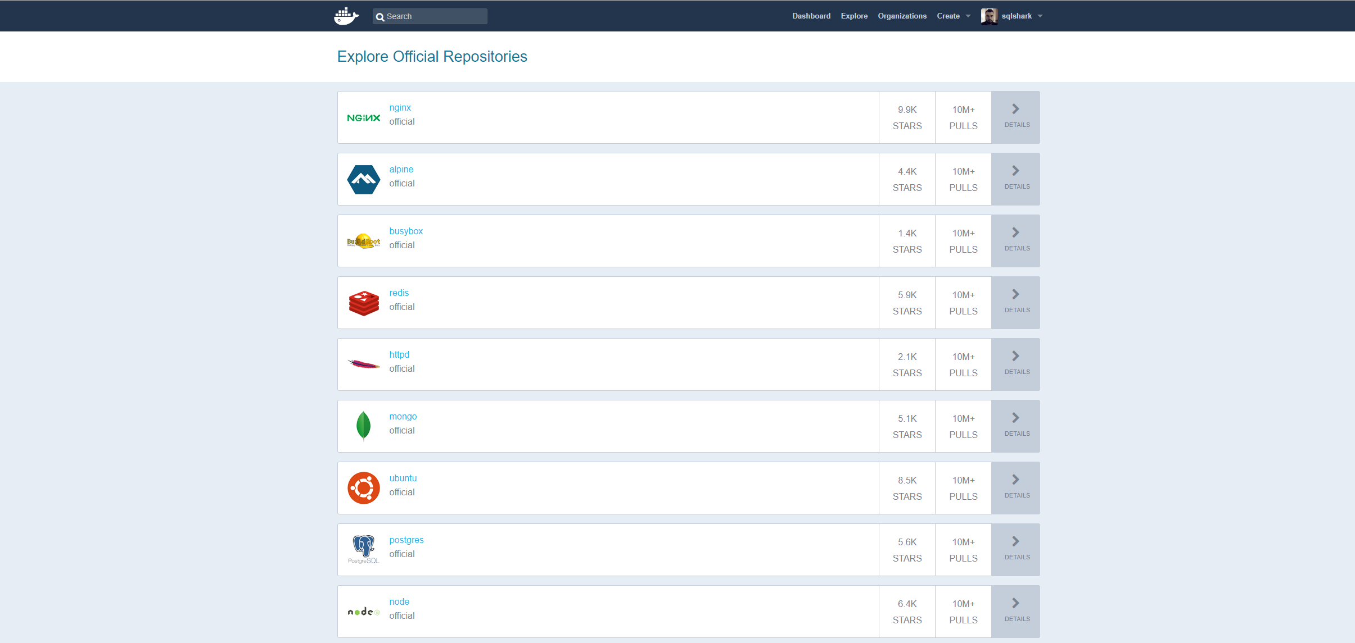
Over to You.
Notes:
https://hub.docker.com/

Slide 9
Important Docker commands
Docker pull <image name>
Docker images
Docker build
Docker run
-d <detatched mode>
--name <Name of run>
Docker ps
Docker stop <run name>
Docker rmi <image name> -f

Slide 10
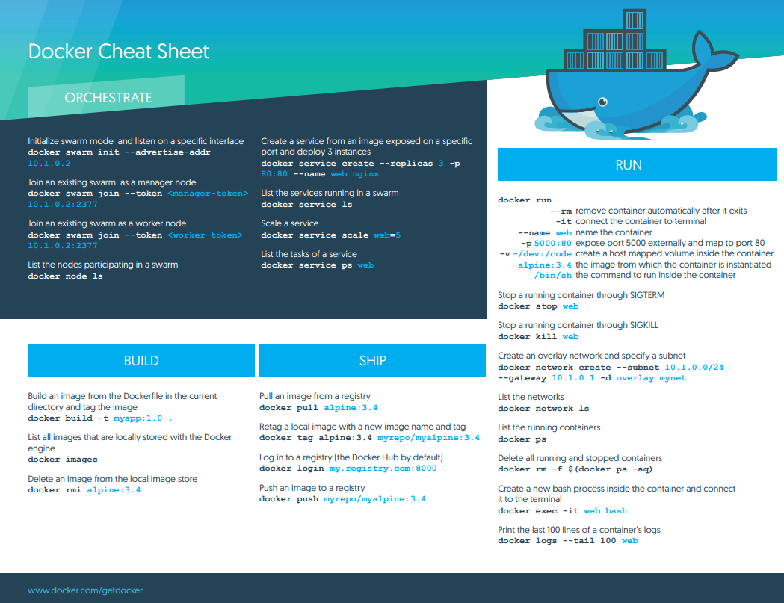

Slide 11
Docker Demo
From an image
Notes:
Docker run hello-world
docker run -d --name web -p 8080:8080 nigelpoulton/pluralsight-docker-ci

Slide 12
Creating an image from scratch
Notes:
docker run -d --name web -p 8080:8080 nigelpoulton/pluralsight-docker-ci

Slide 13
Creating an image from scratch
Base image
Dockerfile
Application code
Any libs, data, dependencies
Notes:
docker run -d --name web -p 8080:8080 nigelpoulton/pluralsight-docker-ci

Slide 14
Docker Demo/Lab
From scratch
Notes:
Docker run hello-world
docker run -d --name web -p 8080:8080 nigelpoulton/pluralsight-docker-ci

Slide 15
Lab 5 - Deploying a container in to Docker
15 minutes

Slide 16
Lab 06 - Deploying your model
15 minutes

